Slide 1
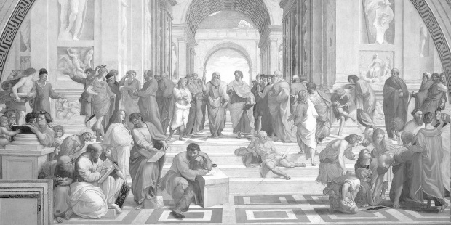
PHILOSOPHY: TOP TIPS FOR SUCCESS!
AQA A Level Philosophy Revision Guide
Question timings
3 mark: 3-5 minutes
5 mark: 5-10 minutes
12 mark: 15-25 minutes
25 mark: 40-50 minutes
Short questions:
Prepare answers to short answer questions carefully.
Memorise precise definitions of key terms for 3 mark answers.
Extend definitions to give a more detailed response in 5 mark questions.
Practise comparing and contrasting ideas for 5 mark answers.
Practise writing out arguments in standard form.
Exam timing
When you know the start times for your exams, calculate at what times you aim to be moving on to each section of the paper.
Plan:
Always plan your 12 and 25 mark answers before you start writing, you can do this in any form!
Writing essay answers:
For 25 mark answers, you should present a coherent argument throughout the essay. Try using this paragraph structure...
View - your view on the idea in relation to the question
Explanation - further explanation of the idea
Evaluation - issues raised by the idea and evaluation of how damaging these are
Link - a conclusion and link back to the question.
Paper 1:
Epistemology 2-7
Moral Philosophy 8-13
Paper 2:
Metaphysics of God 14-20
Metaphysics of Mind 21-26
Revision Dos & Don’ts:
Do revise little and often
Do choose one area of knowledge at a time and master it before moving on to the next one.
Do revisit topics every day, week and month to keep them fresh in your mind.
Do test yourself regularly with quizzes and practice questions.
Don’t spend hours writing out notes, it’s pointless!
Don’t worry! If you don’t know something you can email your teacher, check a book or ask a friend.
Don’t ignore essay-writing, practice it!
Notes:
This booklet is designed to be printed out on A3!

Slide 2
Epistemology: Key ideas
It’s important that you have thought about philosophical issues before you go into the exam. Write your view on these key areas of Epistemology, giving persuasive reasons for your answer.
You can divide the epistemology topic down into 10 ‘chunks’ of knowledge. More detail is on the revision checklist.
Types of knowledge
The JTB account
Responses to Gettier
Direct realism
Indirect realism
Berkeley’s Idealism
Innatism
Intuition and deduction thesis
Doubt
Responses to doubt
Is knowledge justified, true belief? | Can we gain knowledge of the world through our senses?
Is the ultimate source of knowledge reason? | Can we trust knowledge claims about the world?
Don’t forget to check your knowledge of Epistemology against the revision checklist, this is based on the AQA specification:
Notes:
Revision checklist here: https://docs.google.com/document/d/1cf02XONf05GKLOG0vXdzDkB3Xr4bYZWnWBuunBtPkVE/edit?usp=drive_web&ouid=108232754823282250817

Slide 3
Epistemology: What is knowledge?
Issues: are the conditions individually necessary?
Different types of knowledge
Acquaintance knowledge:
Ability knowledge:
Propositional knowledge:
The Tripartite view
Propositional knowledge is defined as justified true belief:
S knows that p if and only if: 1. 2. 3.
“True beliefs are a fine thing and do all sorts of good…[but] they are not worth much until you tether them by working out the reason.”
Socrates (Plato)
Issues: are the conditions jointly sufficient?
Definitions of knowledge according to...
Locke:
Zagzebski:
Socrates:
Plato:
Alternative theories of knowledge | Explanation | Effectiveness in dealing with Gettier
Infallibilism
No false lemmas K = J+T+B+N
Reliabilism K = T+B+R
Virtue ethics K= V=T+B

Slide 4
Epistemology: Perception as a source of knowledge
Direct realism
Indirect realism
Idealism
Issues with direct realism
Issues with indirect realism
Issues with idealism

Slide 5
Epistemology: Reason as a source of knowledge
Innatism
Plato’s argument:
Descartes’ argument:
Leibniz’s argument:
Locke - transparency of ideas
Locke - no ideas are universally held so none is innate
Locke - The Tabula rasa
Issues with innatism
Responses to issues with innatism
The intuition and deduction thesis
Descartes’ method
Clear and distinct ideas
Intuition and deduction
The cogito
Descartes’ arguments for God’s existence
1) The Trademark argument
2) The contingency argument
3) The ontological argument
Descartes’ proof of the external world

Slide 6
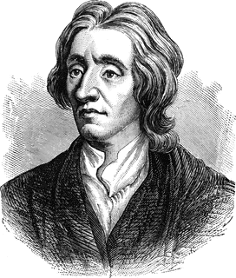
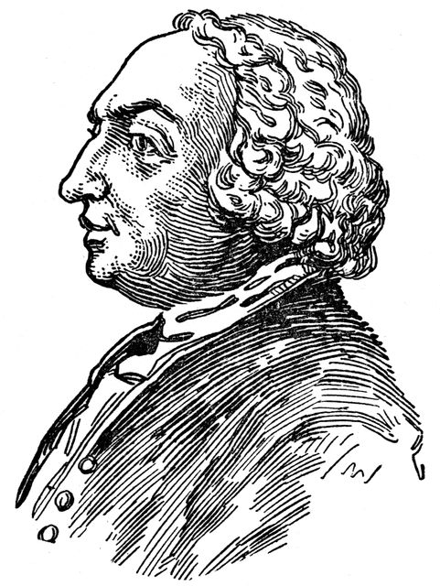
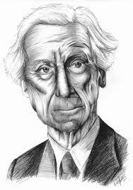
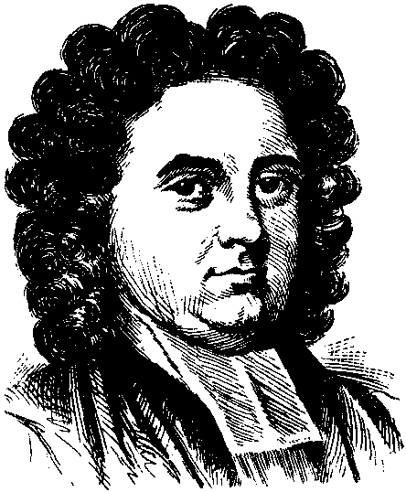
Epistemology: The limits of knowledge
Types of doubt
Empiricist responses to scepticism
Philosophical scepticism | Normal incredulity
Local scepticism | Global scepticism
Locke argued
Hume suggested
Russell recognises
Descartes’ three waves of doubt
Doubting the senses
Berkeley insists
The dreaming argument
Reliabilism as a response to scepticism
The evil demon argument

Slide 7
Epistemology: Practice questions
Exam technique focus:
3 mark questions
3 mark questions test your grasp of essential concepts and your ability to encapsulate them with precision. They may ask you to provide a definition, or briefly outline an idea or theory.
The three mark answer mark scheme from AQA is as follows:
Here is an example of a full marks answer (and examiners’ commentary) for the question, What is philosophical scepticism?
To prepare to answer 3 mark questions you could…
Prepare ‘perfect’ answers for all key terms.
Create flashcards or mind-maps of the key ideas for each topic.
Regularly quiz yourself, or get a friend or family member to quiz you on your perfect answers.
Regularly check your answers against the mark scheme above.
Remember that your knowledge for these answers will help you with other longer answer questions!
3 marks
What are clear and distinct ideas?
Briefly explain what is meant by foundationalism.
What is empiricism?
Briefly explain the theory of idealism.
What is intuition?
5 marks
Outline Plato’s theory of innatism.
Explain Hume’s distinction between matters of fact and relations of ideas.
Outline what is meant by the Cartesian Circle.
Explain the difference between local and global scepticism.
Explain one issue with the evil demon argument.
12 marks
Explain the issues that arise from the tripartite view of knowledge.
Compare and contrast the direct and indirect realist approaches to perception.
Explain the Virtue epistemology approach to knowledge.
Outline and explain the idealist explanation of perception.
Explain how indirect realism may lead to scepticism.
25 marks
Do all simple ideas come from impressions?
Evaluate the claim that any concept is innate.
How do you know that you are not dreaming now?
“We cannot know anything.” Discuss.
Does Descartes succeed in producing a priori knowledge?
Marks | Levels of response mark scheme
3 | A full and correct answer, given precisely, with little or no redundancy.
2 | The substantive content of the answer is correct, but there may be some redundancy or minor imprecision.
1 | Relevant, but fragmented, points.
0 | Nothing written worthy of credit. Indicative content

Slide 8
It’s important that you have thought about ethical issues before you go into the exam. Write your view on these key areas of Moral Philosophy, giving persuasive reasons for your answer. Don’t forget to refer back to your applications booklet too!
Moral Philosophy: Key ideas
You can divide the Moral Philosophy topic down into 10 ‘chunks’ of knowledge. More detail is on the revision checklist.
Utillity
Issues with utility
Kant
Issues with Kant
Aristotle
Issues with Aristotle
Application and comparison
Origins and status
Realism and issues
Anti-realism and issues
Is it best to do the greatest good for the greatest number? | Should rationality and autonomy form the basis of morality?
Is virtue ethics a worthy alternative to consequentialist and deontological ethics? | Should moral language be understood in naturalistic terms?
Don’t forget to check your knowledge of Moral Philosophy against the revision checklist, this is based on the AQA specification:
Notes:
Revision checklist here: https://docs.google.com/document/d/1cf02XONf05GKLOG0vXdzDkB3Xr4bYZWnWBuunBtPkVE/edit?usp=drive_web&ouid=108232754823282250817

Slide 9
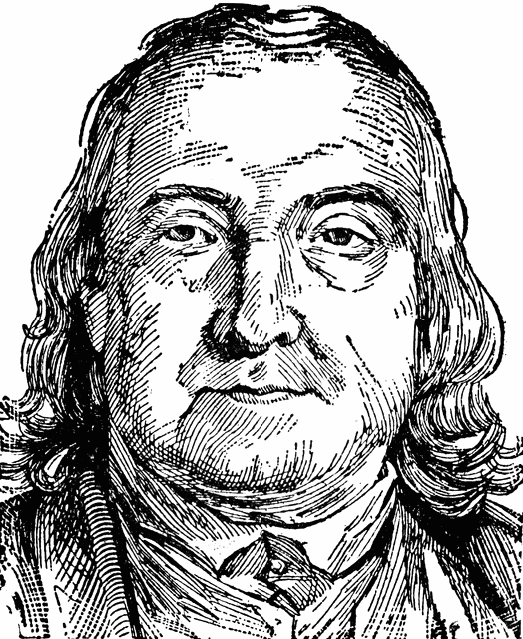
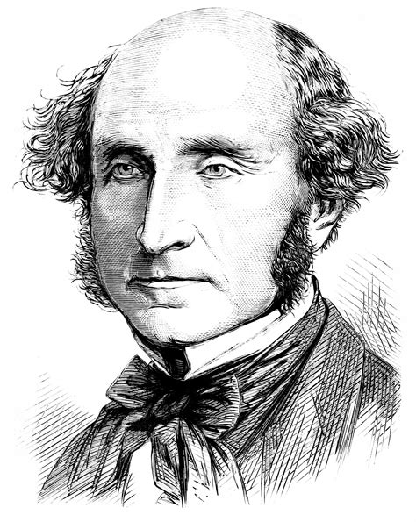
Moral Philosophy: Utilitarianism
Issues with utilitarianism
Issue | Explanation/ evaluation
“The tyranny of the majority.” (J.S. Mill) Fairness and individual liberty/ rights
Problems with calculating utility
Partiality
Moral integrity
Is pleasure the only good? Nozick’s pleasure machine
Bentham’s quantitative hedonistic utilitarianism
The principle of utility -
The utility calculus -
“...and it is the greatest happiness of the greatest number that is the measure of right and wrong.”
Bentham
Bentham’s version is a form of act utilitarianism because...
Mill’s qualitative hedonistic utilitarianism
Mill’s ‘proof’ of the greatest happiness -
Higher and lower pleasures -
Strong and weak rule utilitarianism -
“It is better to be a human dissatisfied than a pig satisfied; better to be Socrates dissatisfied than a fool satisfied.”
J.S. Mill
Mill’s version is a form of rule utilitarianism because...
Similarities and differences with…
Kantian ethics Aristotelian virtue ethics
Non-hedonistic utilitarianism
Preference utilitarianism -
Ideal utilitarianism -

Slide 10
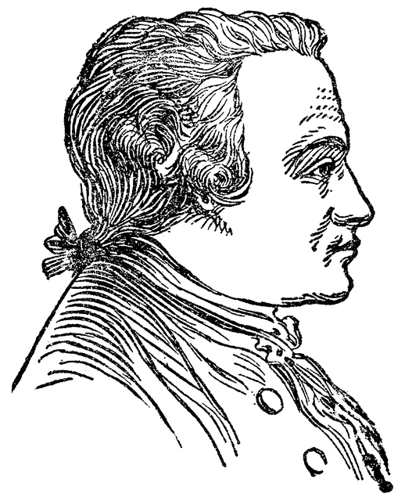
Moral Philosophy: Kantian deontological ethics
The foundations of Kantian ethics
Good will as a source of moral worth
Humans as imperfectly rational beings
Acting in accordance with duty vs acting out of duty
Universal moral laws
Issues with Kantian ethics
1)
2)
3)
4)
5)
“Act according to the maxim [rule] whereby you can at the same time will that it should become a universal law without contradiction.”
Kant
Difference between contradiction in will and contradiction in conception
The categorical imperative
The universal law formulation
The humanity formulation
Similarities and differences with…
Utilitarianism Aristotelian virtue ethics

Slide 11
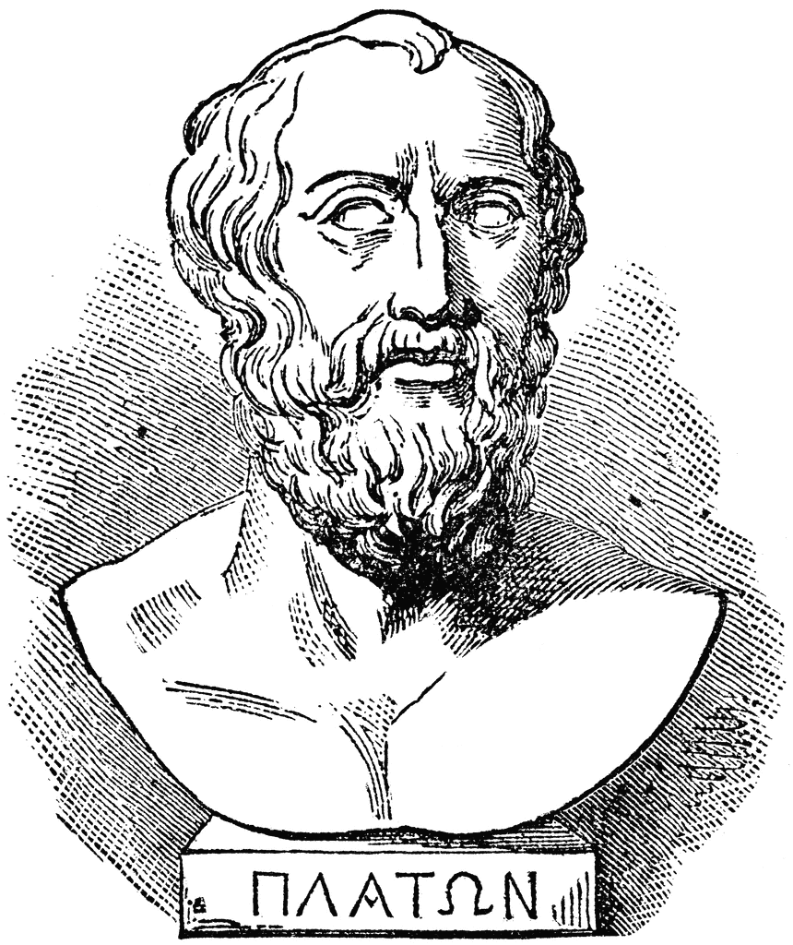
Moral Philosophy: Aristotelian virtue ethics
“Virtue, then, is a state of character concerned with choice, lying in a mean.”
Aristotle
The ‘End’ of Aristotelian ethics
The concept of ‘The Good’ for humans
Eudaimonia as the final end
The relationship between Eudaimonia and pleasure
Function
The argument
The relationship between virtues and functions
Virtues and vices
Similarities and differences with…
Kantian ethics Utilitarianism
Practical reasoning & practical wisdom
Issues with Aristotelian ethics
Does it give clear guidance? | Are there clashing/ competing virtues? | Is the argument circular? | Do virtues have to contribute to eudaimonia?

Slide 12
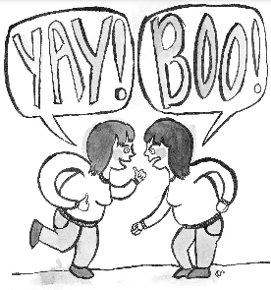
Moral Philosophy: Meta-ethics
Key concepts of meta-ethics
Cognitivism is... | Non-cognitivism is...
Realism is... | Anti-realism is...
The
Origin of moral principles
Reason
Emotions
Society
Moral realism
Utilitarianism and moral naturalism
Moral non-naturalism & Moore’s intuitionism
Moral anti-realism
J.L. Mackie’s error theory
Ayer’s emotivism
Hare’s prescriptivism
Problems with moral realism
Problems with moral anti-realism

Slide 13
Moral Philosophy: Practice questions
Exam technique focus:
5 mark questions
5 mark questions ask you to go a little further than just a definition, you need to give a full explanation of a philosophical issue, showing that you have a detailed understanding of the complexity involved. The question may have one of these focuses:
Explain a particular argument - you should show awareness of the way the argument is structured, showing the distinction between the premises and conclusion.
Make distinctions between particular concepts - you should be clear about the logical differences between ideas.
You may include examples drawn from texts in your answers, but you do not need to include quotes.
To get higher marks on this answer, AQA say:
Here’s a sample
answer to the
question
‘Outline what is
meant by
extension as
a primary quality.’
3 marks
Briefly explain the theory of preference utilitarianism.
What is prescriptivism?
What is the naturalistic fallacy?
Briefly explain what is meant by the Golden Rule.
What is hedonism?
5 marks
Outline the difference between virtues and vices.
Explain one issue with Bentham’s utility calculus.
Explain J.S. Mlil’s proof of utilitarianism.
Outline the two-tier version of utilitarianism.
Explain what is meant by universal moral laws.
12 marks
Explain how Kant’s deontology might be applied to stealing.
Compare and contrast the universal law and the humanity formulations of Kant’s categorical imperative.
Explain how a Virtue ethicist might morally judge simulated killing.
Outline and explain the different formulations of the categorical imperative.
Explain how the categorical imperative may raise issues of clashing or competing duties.
25 marks
Is it possible to derive an ‘ought’ from an ‘is’?
Should we always do what could become a universal law?
Is Virtue Ethics effective as a theory of moral value?
Evaluate the Aristotelian position on simulated killing.
Moral language should be understood in non-natural terms. Discuss.
Marks | Level of response mark scheme
5 | A full, clear and precise explanation. The student makes logical links between precisely identified points, with no redundancy.
4 | A clear explanation, with logical links, but some imprecision/redundancy.
3 | The substantive content of the explanation is present and there is an attempt at logical linking. But the explanation is not full and/or precise.

Slide 14
It’s important that you have thought about philosophical issues before you go into the exam. Write your view on these key areas of philosophy of religion, giving persuasive reasons for your answer.
Metaphysics of God: Key ideas
You can divide the Metaphysics of God topic down into 10 ‘chunks’ of knowledge. More detail is on the revision checklist.
Concept of God
Ontological
Issues with the Ontological argument
Design
Issues with the Design argument
Cosmological
Issues with the Cosmological argument
Problem of evil and issues
Religious language
University debate
Is the concept of God coherent? | Can design prove the existence of God?
Is God the ‘First Cause’? | Is religious language meaningful?
Don’t forget to check your knowledge of Metaphysics of God against the revision checklist, this is based on the AQA specification:
Notes:
Revision checklist here: https://docs.google.com/document/d/1_AQR3FyFaxIGbuvTnmMBfdvn8y5dXYkSqwwB_stRFHg/edit

Slide 15
Metaphysics of God: The concept of God and Problem of evil
God’s attributes and arguments for the incoherence of the concept of God
The problem of evil
God as omniscient | The compatibility of omniscience and free human beings
God as omnipotent | The paradox of the stone
God as omnibenevolent | The Euthyphro dilemma
God as eternal or everlasting | The compatibility of eternality and free will
Mackie’s logical problem of evil:
Darwin, Hume and Rowe’s evidential problem of evil:
VS
Responses to the problem of evil
1) Atheists claim there is no God
Sartre suggested...
Mary Midgley argued...
2) Alternative theologies
Theists argue that God does exist but…
However….
3) The afterlife defence
Hick claims that evil is balanced with…
However...
4) The free will defence
St Augustine and Plantinga argue...
However...
5) The soul-making theodicy
St Irenaeus and Hick claim...
However...
VS
VS
VS

Slide 16
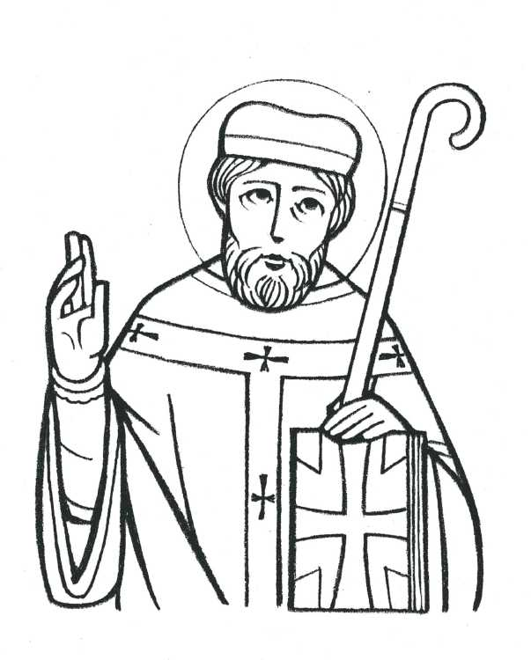
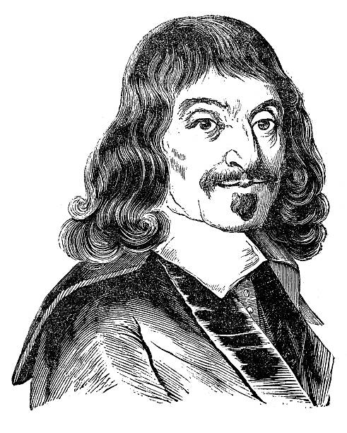
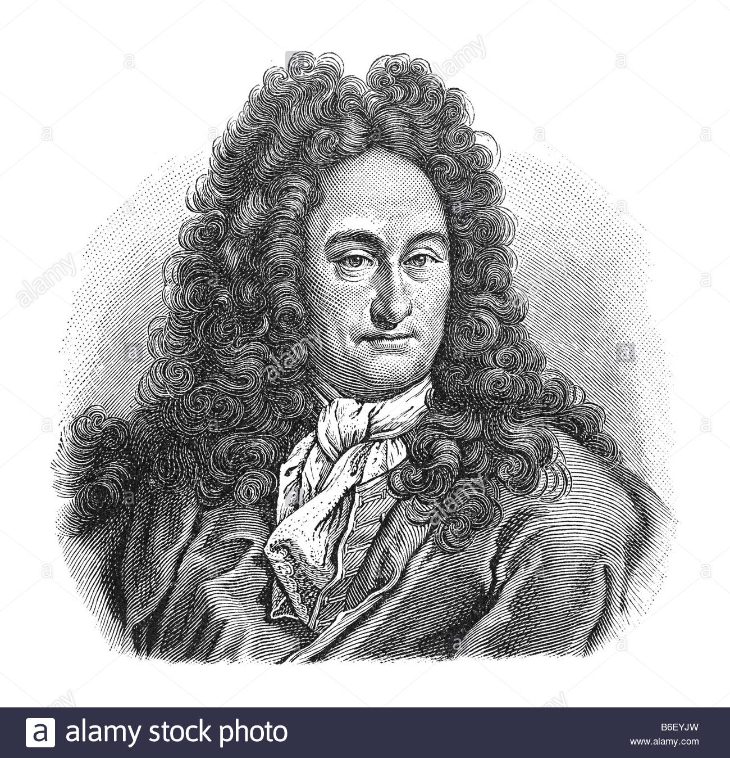
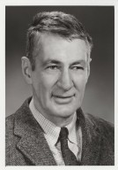
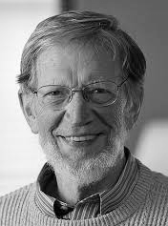
Metaphysics of God: The ontological argument
Features of ontological arguments
The word ‘ontology’ means…
They are deductive, which means…
They concern only a priori definitions, which means…
So the conclusions are limited as...
Ontological arguments
 | In standard form... | Key features
Anselm
Descartes
Leibniz
Malcolm
Plantinga
Gaunilo’s perfect island objection
Issues with ontological arguments
Kant’s objections based on existence not being a predicate
Hume’s empiricist objections

Slide 17
Metaphysics of God: Design
“Every indication of contrivance, every manifestation of design, which existed in the watch, exists in the world of nature.”
Paley
Features of teleological arguments
The term ‘teleology’ means…
They are a posteriori, meaning...
They can be deductive, inductive and abductive because...
In contrast to cosmological arguments, they offer more detail about the nature of God, such as...
Paley’s argument from spatial order and purpose
In Natural Theology, Paley notices the variety of features of a watch that indicate spatial order and purpose. Paley’s design argument may be presented as...
=
Swinburne’s argument from temporal order/ regularity
Attempting to avoid Hume’s objections, Swinburne acknowledges that he cannot prove the existence of God. He also makes a distinction between ‘spatial order’ (regularities of co-presence) and ‘temporal order’ (regularities of succession). Within these parameters her suggests the following argument...
“An agent produces a celestial harmony like a man who sings a song.”
Swinburne
Issues with the design argument
Further design arguments
Aquinas’ 5th way is an argument from analogy, it says…
Hume’s fictional character Cleanthes also puts forward a design argument, suggesting...
Hume’s objections to design arguments from analogy | Hume and Paley’s problem of spatial disorder | Hume’s argument whether God is the best or only explanation | Kant’s suggestion that design may be explained by a ‘worldly architect’ not God

Slide 18
Metaphysics of God: Cosmological
“I should say the universe is there and that is it.”
Russell
Features of cosmological arguments
The term ‘cosmological’ means…
They are a posteriori, meaning...
They take the logical form of deductive arguments because...
However, atheists are suspicious of them because...
Aquinas’ first 3 ways
Motion
Causation
Contingency
The Kalam argument
Descartes’ cosmological argument
Issues with the cosmological argument
The possibility of an infinite series | Hume’s objection to the causal principle | The fallacy of composition | Russell and the impossibility of an infinite being
Wider cosmological arguments
Plato:
Aristotle:
Leibniz:

Slide 19
Metaphysics of God: Religious language and the university debate
A key distinction
The University debate: Flew, Hare & Mitchell
Cognitivism
Non-cognitivism
Antony Flew on falsification
The verification principle
The Vienna Circle, unified in their rejection of metaphysical ‘nonsense’ became the Logical Positivists - a movement who argued that knowledge should be based on verifiable facts.
Strong verification is…
Weak verification is…
When applied to the metaphysics of God, the verification principle has serious implications for religious language...
“What would have to occur or have to have occurred to constitute for you a disproof of the love of, or the existence of, God?”
Flew
A.J. Ayer’s verification principle suggests…
Basil Mitchell’s response (the Partisan)
Issues with the verification principle
Hare’s response to Flew (bliks and the lunatic)
Hick’s eschatological verification | It is far too strong! | It is self-refuting.
“The meaning of a word is its use in the language.”
Wittgenstein

Slide 20
Metaphysics of God: Practice questions
Exam technique focus:
12 mark questions
12 mark questions require a longer response. Questions may require you to compare or contrast different ideas, or refer to arguments with several steps or criticisms that you need to pick apart.
AQA give the following criteria for the highest marks:
To ensure you hit this criteria, you could use this acronym when planning, writing and checking your answer:
Precision - Have you precisely picked apart the key points of the question? e.g Refer to specific premises or issues.
Explanation - Have you explained ideas clearly and correctly?
Detail - Have you used relevant details? e.g Scholarly ideas, examples and quotes.
Language - Have you used a range of clearly defined technical terms?
You should plan your answer before you start writing, like this:
3 marks
What is deism?
Briefly explain what is meant by eschatology.
What is the verification principle?
What is revelation?
Briefly explain the problem of evil.
5 marks
Outline the difference between verification and falsification.
Outline one issue with the concept of God as omnipotent.
Explain Gaunilo’s objection to the ontological argument.
Outline Descartes’ ontological argument.
Explain Paley’s argument from spatial order and purpose.
12 marks
Compare and contrast the versions of the cosmological arguments put forward by Descartes and Leibniz.
Outline and explain the Swinburne’s argument from temporal order.
Explain how Hume objects to the teleological argument.
Explain Aquinas’ cosmological arguments for God’s existence.
Explain Hick’s response to the problem of evil (soul-making).
25 marks
Is the concept of God coherent?
‘God cannot be conceived not to exist.’ Evaluate this claim.
Is God the best explanation for the appearance of design in nature?
To what extent does the teleological argument survive its criticisms?
Is God the First Cause?
Marks | Level of response mark scheme
10-12 | The answer is set out in a precise, fully-integrated and logical form. The content is correct and demonstrates detailed understanding. Points are made clearly and precisely. Relevance is sustained, with very little or no redundancy. Philosophical language is used precisely throughout.

Slide 21
It’s important that you have thought about philosophical issues before you go into the exam. Write your view on these key areas of philosophy of Mind, giving persuasive reasons for your answer.
Metaphysics of Mind: Key ideas
You can divide the Metaphysics of Mind topic down into 10 ‘chunks’ of knowledge. More detail is on the revision checklist.
Mental states
Substance dualism
Property dualism - zombies
Property dualism - knowledge/Mary
Issues with dualism
Behaviourism
Issues with behaviourism
Mind-brain type identity theory
Eliminative materialism
Functionalism
Are human beings composed of two different types of substance? | Does property dualism solve the problems faced by substance dualism?
What is the relationship between the mind and the brain? | Can a computer have a mind?
Don’t forget to check your knowledge of Metaphysics of Mind against the revision checklist, this is based on the AQA specification:
Notes:
Revision checklist here: https://docs.google.com/document/d/1rfB5jU1KZUiB8-OUy9A-Y0Pq_cBGV8B_pDlssP3JVnk/edit

Slide 22
Metaphysics of Mind: Mental states & Substance dualism
Features of mental states
Intentional properties:
Phenomenal properties (qualia):
Descartes thought the mind is not the same as the brain.
“Strictly speaking, then, I am simply a thing which thinks - a mind, a soul, or intellect, or reason.”
Descartes
The mind is non-spatial and conscious. This is private and non-observable.
The body is located in time and space. It is material and publicly observable.
“For we are not able to conceive of half of a mind as we can do of the smallest of all bodies; so that we see that not only are their natures different but even in some respects contrary to one another.”
Descartes
Key features of Descartes’ substance dualism
The indivisibility argument
The indivisibility argument can be
summarised as:
P1:
P2:
C:
The conceivability argument
The conceivability argument can be
summarised as:
P1:
P2:
P3:
C:
Descartes uses Leibniz’s law, which says...
Descartes’ argument relies on a distinction between logical, physical and metaphysical possibility...
Issues with the indivisibility argument
1) The mental is divisible (Hume and neuroscience):
2) Not everything thought of as physical is divisible (Ryle):
Issues with the conceivability argument
1) What is conceivable may not be metaphysically possible (Arnauld) & The Masked man fallacy:
2) What is metaphysically possible tells us nothing about the actual world:
3) Mind without body is not conceivable:
4) The dependence of mind on brain:
5) Evolutionary history:

Slide 23
Metaphysics of Mind: Property dualism
The philosophical zombies argument
C
The knowledge/ Mary argument
Issues with the zombie argument
1) A zombie is not conceivable
2) What is metaphysically possible tells us nothing about the actual world
3) What is conceivable need not be metaphysically possible
Key features of property dualism
Property dualists believe that there is one….
But they still remain dualists as they claim that the brain has non-physical...
The theory refers to consciousness as real but not….
Mental properties are seen as….
These emergent properties are irreducible to….
It appears better able to accommodate scientific evidence because…
Issues with the knowledge/ Mary argument
1) Mary gains no new propositional knowledge, only acquaintance knowledge
2) All physical knowledge would include knowledge of qualia
3) Mary gains new propositional knowledge
4) Qualia do not exist and so Mary gains no new propositional knowledge
Issues with dualism, including... The problem of other minds Ryle’s category mistake | Issues facing interactionist dualism Conceptual interaction problem The empirical interaction problem | Issues facing epiphenomenalist dualism Introspective self-knowledge Phenomenology of mental life Natural selection/ evolution

Slide 24
Metaphysics of Mind: Behaviourism & Mind-brain type identity theory
Philosophical behaviourism
Mind-brain type identity theory
Behaviourists solve the problem of other minds by suggesting…
They suggest that talk about minds is….
Numerical identity
Qualitative identity
Hempel’s hard behaviourism | Ryle’s soft behaviourism
Key features of the theory include…
“Psychology is an integral part of physics.”
Hempel
Issues facing mind-brain type identity theory
“To possess a dispositional property is not to be in a particular state...it is to be bound or liable to a particular state when a particular condition is realised.”
Ryle
Putnam suggests that talk about the brain doesn’t mean the same as talk about the mind
Applying Leibniz’s law - The spatial location problem
Issues facing philosophical behaviourism
Dualist arguments appealing to evidence of introspection
Issues
Block emphasises the chauvinism of the type identity theory

Slide 25
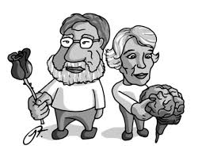
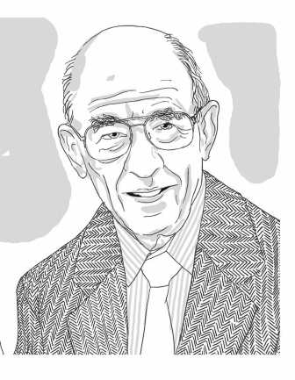
Metaphysics of Mind: Eliminative materialism & Functionalism
Eliminative materialism is...
Functionalism is...
Issues facing eliminative materialism
Issue | Explanation
The certainty about the reality of mental states
Folk psychology has good predictive and explanatory power
Eliminative materialism as a theory is self-refuting
Key features of Eliminative materialism
A rejection of folk psychology -
Elimination rather than reduction -
The development of neuroscience -
“Our common sense conception of psychological phenomena constitutes a radically false theory…”
Paul Churchland
Key features of Functionalism
Reducing mental states to functional roles
Advantages over behaviourism
Advantages over identity theory
Issues facing functionalism
Issue | Explanation
The possibility of a functional duplicate with inverted qualia
The knowledge/Mary argument can be applied to functional facts
The possibility of a functional duplicate with no qualia
“I shall, in short, argue that pain is not a brain state, in the sense of a physical-chemical state of the brain...but another kind of state entirely. I propose the hypothesis that pain, or the state of being in pain, is a functional state of a whole organism.”
Putnam

Slide 26
Metaphysics of MInd: Practice questions
Exam technique focus:
25 mark questions
25 mark questions are primarily based on evaluation and have a much bigger proportion of marks for weighing up arguments and reaching a conclusion. They test your capacity to develop an argument in defence of your own judgement.
AQA give the following criteria for the highest marks:
Here’s an exemplar introduction to question 4 on the left:
The problem of other minds is the sceptical question of what we can know about other minds, commonly used as an argument against dualism. Firstly, Wittgenstein raises the epistemological issue that we lack any firm basis for postulating the very existence of other minds. Secondly, he highlights a conceptual issue of whether we can even form the concept of other minds via his private language argument. Superficially, the behaviourist claim that minds are reducible to behaviours appears to solve the problem of other minds, as one can believe a person is minded if one can observe what another person says and does. However, this argument is misguided, neglecting to account for the circularity of behaviourist claims, as well as the more plausible ‘Super-Spartans’ example which suggests that there may be a particular mental state, or indeed mind, without any behavioural manifestation.
3 marks
What is analytic reduction?
Briefly explain what is meant by contingent identity.
What are automata?
Briefly explain the problem of other minds.
What is epiphenomenalism?
5 marks
Explain how the argument from analogy can be used to solve the problem of other minds.
Outline Descartes’ conceivability argument for substance dualism.
Explain the difference between an ontological reduction and an analytic reduction.
Outline the chinese room argument.
Explain Hempel’s argument for hard behaviourism.
12 marks
Explain the physicalist claim that the mind is reducible to behaviour.
Explain the issues that arise from philosophical behaviourism.
Explain the criticism of eliminative materialism that says it is self-refuting.
Outline functionalism and explain how the knowledge/Mary argument can be used in criticism of the theory.
Explain how the possible asymmetry between self-knowledge and knowledge of other people’s mental states might challenge philosophical behaviourism.
25 marks
Can property dualism successfully survive its criticisms?
What can we know about other minds?
Does dualism make a category mistake?
Can philosophical behaviourism solve the problem of other minds?
Can mental states be reduced to functional roles?
Marks | Level of response mark scheme
21-25 | The student argues with clear intent throughout and the logic of the argument is sustained. The student demonstrates detailed and precise understanding throughout. The conclusion is clear, with the arguments in support of it stated precisely, integrated coherently and robustly defended. Arguments and counter-arguments are stated in their strongest forms. Reasoned judgements are made, on an ongoing basis and overall, about the weight to be given to each argument. Crucial arguments are clearly identified against less crucial ones. Philosophical language is used precisely throughout.

