Slide 1
BTEC Level 3 Health and Social Care Human Lifespan Development Therapy and Testing

Slide 2
Being specific
Examiners’ report link: ‘candidates should carefully read each question and be precise in their responses’.
In order to ensure that you gain the highest marks in the exam, you must ensure that you are being specific, especially when looking at short answer questions. It is essential that you use specific terminology that is linked to the question, e.g. a milestone that is linked to the age of the child.
Timelines are a good way to learn the milestones in each life stage that could come up in the exam.
Your turn
Create a timeline for each of the six life stages, including all the key PIES terminology. For example, continue with the timeline below…
Egocentric
Early childhood
Infancy
Fine motor skills
Notes:
June 2019 examiners report: https://qualifications.pearson.com/content/dam/secure/silver/all-uk-and-international/btec-nationals/health-and-social-care/2016/external-assessments/31490H_unit1_pef_20190814.pdf?428383501864071

Slide 3
Being specific
Age | Gross motor skills | Fine motor skills
Newborn | Primitive reflexes, such as grasp
1 month |  | Open hands to grasp finger
3 months |  | Can briefly grasp a rattle
6 months |  | Moves objects from hand to hand, can pick up dropped toys if they are in sight
9-10 months
12-13 months | Stands alone, can walk without help | Manipulates and places toys
18 months
2 years | Propels a sit-on toy with their feet, throws a large ball
2 and a half years |  | Uses a spoon and fork, builds a tower of 7-8 blocks
You will also need to be specific with the milestones so that in the exam you don’t lose marks on shorter answer questions.
Your turn
Complete the table with specific fine and gross motor skill milestones in infancy.

Slide 4
Short answer questions
Examiners’ report link: ‘brevity and accuracy are especially important in the responses to the identify questions’.
In order for you to gain the best marks possible, it is essential that you gain all of the marks available in shorter answer questions.
Using short answer questions as a key part of your revision is essential for you to build up a bank of short answers.
You can be specific to the current topic you are studying. You can find a range of short answer questions on Pearson’s website https://qualifications.pearson.com/en/qualifications/btec-nationals/health-and-social-care-2016.coursematerials.html#filterQuery=Pearson-UK:Category%2FExternal-assessments
Top tips: complete these short answer questions under timed conditions so that you get used to exam time constraints. You can also use the examiners’ reports to read some model answers to help you.
Your turn
See the next few slides for an example of how you can test yourself with short answer questions.
Notes:
June 2019 examiners report: https://qualifications.pearson.com/content/dam/secure/silver/all-uk-and-international/btec-nationals/health-and-social-care/2016/external-assessments/31490H_unit1_pef_20190814.pdf?428383501864071

Slide 5
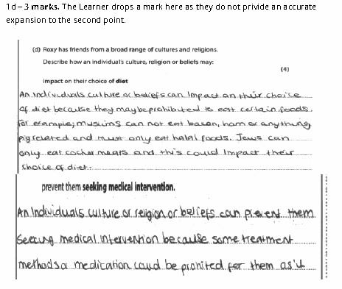
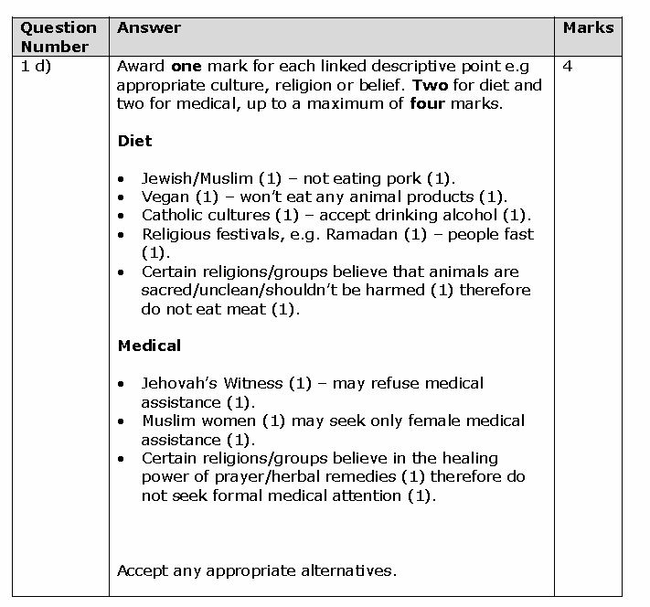
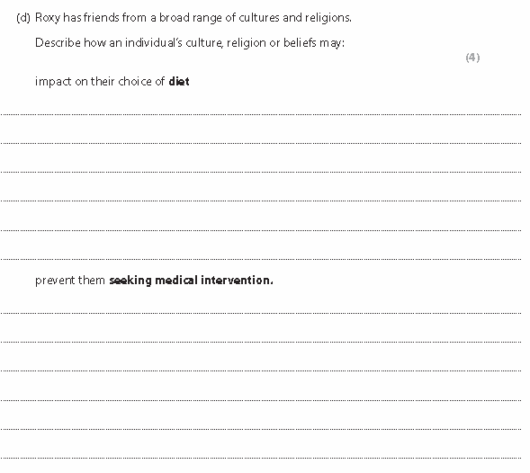
To start…
Complete the short answer questions
Notes:
Ensure that this is viewed in slide show mode to show full effect

Slide 6
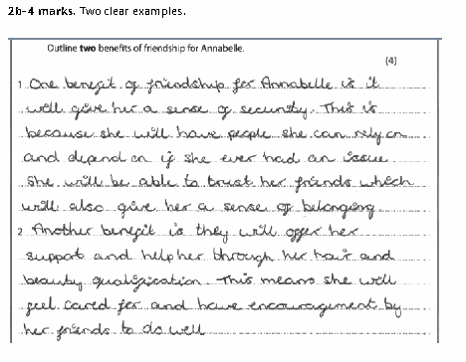
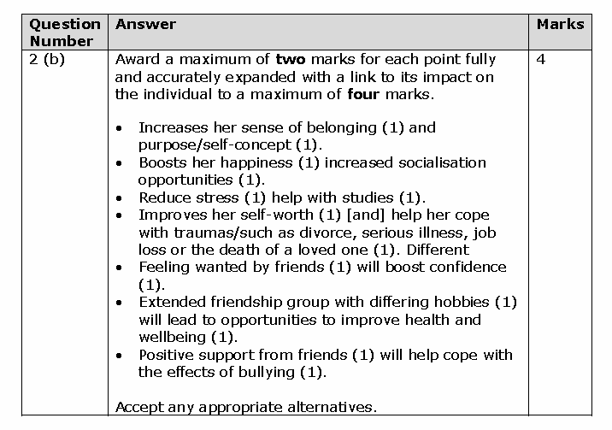
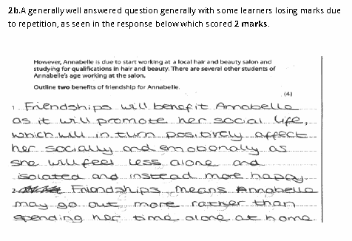
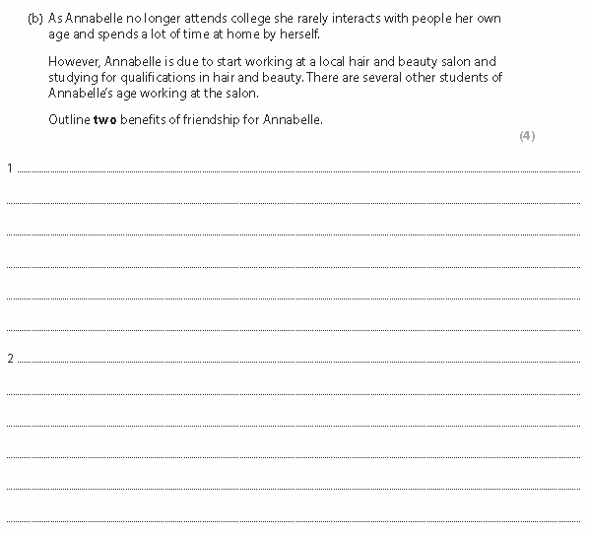
To start…
Complete the short answer question
Notes:
Ensure that this is viewed in slide show mode to show full effect

Slide 7
Short answer questions
Your turn
Have a go at these short answer questions:
Describe the possible physical effects of reduced levels of oestrogen when entering the menopause. [4]
Describe the potential effects of starting puberty on someone’s emotional development. [4]
Identify the principles of growth and development. [2]
Outline key differences between nature and nurture. [2]

Slide 8
Command words
Examiners’ report link: ‘candidate’s response should be based on the command word in the question’.
https://www.youtube.com/watch?v=NHA7IhavJPI Watch the following video to help you to understand command words.
Use the command word definitions given by Edexcel. You can find the command word definitions using the following link to the Edexcel website.
https://qualifications.pearson.com/content/dam/pdf/BTEC-Nationals/Health-and-Social-Care/2016/external-assessment/Health_Social_Care_glossary.pdf
Your turn
To practise responding to the command words, you can write about something personal, e.g. your favourite film. Use the following prompts:
Identify your film’s title.
Describe your favourite character.
Explain the plot.
Justify how well your chosen film did at the box office.
To what extent did your film do well?
Notes:
June 2019 examiners report: https://qualifications.pearson.com/content/dam/secure/silver/all-uk-and-international/btec-nationals/health-and-social-care/2016/external-assessments/31490H_unit1_pef_20190814.pdf?428383501864071

Slide 9
To what extent…
Examiners’ report link: ‘To what extent…generally require a balanced argument to gain the highest marks’.
You need to understand that a question with this command word acts as a debate and usually explores big questions, such as nature vs nurture.
On questions like these, you need to give answers that are ‘for and against’ or ‘advantages and disadvantages’. You will need to use evidence to support your opinion; this is usually when you can use theory to support your point. You must then come to a conclusion at the end.
Your turn
Debate with friends some of the big questions. For example, ‘To what extent does nature impact the development of individuals?’
Remember nature vs nurture needs to be linked to Gesell and Bandura.
Notes:
June 2019 examiners report: https://qualifications.pearson.com/content/dam/secure/silver/all-uk-and-international/btec-nationals/health-and-social-care/2016/external-assessments/31490H_unit1_pef_20190814.pdf?428383501864071

Slide 10
Debate sheet…
‘To what extent does nature impact the development of individuals?’
Arguments for…
Arguments against…
Links to theory:
Conclusion:

Slide 11
Theory application
Examiners’ report link: ‘Candidates should aim to utilise appropriate theorists’ in their response’.
You need to know all the theories in detail before you can apply them to the questions.
Once you know a theory, a top tip is to do a 5 minute challenge every two weeks, where you write everything you know about that theory down on paper. You can use prompts to help: e.g. for Attachment Theory you will need to identify Bowlby’s Theory, Schaffer and Emerson’s Stages, Strange Situations Experiment, key words like ‘stranger anxiety and separation anxiety’ and ‘secure attachment’.
If you do this under exam conditions in a coloured pen, then afterwards, you can use your notes in a different colour pen to review your answer and include anything you missed off.
Top tip: don’t forget about theories taught at the beginning of the year. Keep revising so you are familiar with the main points.
Use the templates on the next few slides to help…
Notes:
June 2019 examiners report: https://qualifications.pearson.com/content/dam/secure/silver/all-uk-and-international/btec-nationals/health-and-social-care/2016/external-assessments/31490H_unit1_pef_20190814.pdf?428383501864071

Slide 12
Attachment Theory
Key term | Description
Bowlby’s Theory – separation anxiety, stranger anxiety
Biological pre-programmed
Strange Situations Experiment (Ainsworth)
Secure attachment
Schaffer and Emerson’s Stages

Slide 13
Cognitive Theory
Key term | Description
Piaget’s stages (four stages)
Egocentrism
Conservation experiments
Schemas
Criticisms

Slide 14
Language Acquisition Theory
Key term | Description
Language acquisition device
Universal grammar
Nature vs nurture
Innate
Criticisms

Slide 15
Nature vs Nurture
Key term | Description
Bandura’s Social Learning Theory
Bobo Doll Experiment
Gesell’s Maturation Theory
Reinforcement
Predisposition
Stress Diathesis Model
Criticisms

Slide 16
Ageing Theories
Key term | Description
Social Disengagement Theory
Activity Theory
Holmes-Rahe Readjustments Ratings Scale (linked to later adulthood)
Criticisms of Social Disengagement Theory

Slide 17
Dual Coding Theory
https://www.youtube.com/watch?v=BHeShGQqh8Y Watch the following video to support your learning here.
The use of images can be essential in helping you to remember key terms and topics.
Use images with all the theories so that you can link words and key terms to images in order to better remember them.
Use these images within your work and revision materials.
You can test yourself on the theories by just using selected images as prompts to help jog your memory.
Your turn
Have a go at creating some image only worksheets/slides for a selection of topics or theories. There is a completed example on the next slide, for Attachment Theory, to help you get started.

Slide 18
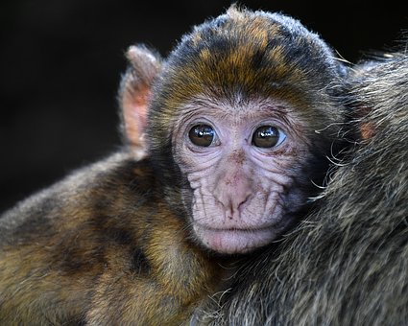
3
1
2
5
4
6
Notes:
All images are taken from pixabay.com
Answers
1 – attachment / secure attachment
2 – critical period – 0-2 years
3 – future relationships
4 – Harlow’s Monkeys – need for love
5 – separation anxiety
6 – biologically pre-programmed

Slide 19
Expanding answers
Examiners’ report link: ‘A more refined and expanded answer was needed to reach higher mark bands’.
You need to make sure you structure your answers in order to make valid expansions and links to development and/or theories.
The use of PEEL as a technique can be applied here (see following slide).
Notes:
June 2019 examiners report: https://qualifications.pearson.com/content/dam/secure/silver/all-uk-and-international/btec-nationals/health-and-social-care/2016/external-assessments/31490H_unit1_pef_20190814.pdf?428383501864071

Slide 20
PEEL
https://www.youtube.com/watch?v=h1dQvPtwp0I Watch the following video to help with this strategy.
P – Point – state the point of your paragraph but you don’t have to write the question again as your answer stem because this can waste time.
E – Explain/Elaborate – explain the point you are making. You might use one of the PIES to explain your point.
E – Evidence/Example – provide evidence or an example to support your explanation. Use theory or the case study here.
L – Link – bring everything together. Essentially linking back to the question and writing a conclusion to that specific point being made.
Notes:
Image used from pixabay.com

Slide 21
Expanding answers
Your turn
Top tip: If you write your own mark schemes for exam questions, then analyse existing answers before writing your own, this will help you to better structure your answers.
See the following slides for examples of how you can do this yourself with prompts. Have a go!

Slide 22
Q – Evaluate the impact on society of an ageing population.
Working in groups, read the long answer exam question and write bullet points/notes on what you should include in the answer. Write your own mark scheme!
Using the real mark scheme, add in green pen what you missed off your mark scheme.
Now read the two answers in the examiners’ report. Highlight the good points within the answer.
For the 7-mark answer – write what they did well and what they missed out.
For the 4-mark answer – write what they need to do to improve.
Use your mark scheme to write a model answer for this question.
Notes:
June 2018 paper, mark scheme and examiners report from the Edexcel Website
https://qualifications.pearson.com/en/qualifications/btec-nationals/health-and-social-care-2016.coursematerials.html#filterQuery=Pearson-UK:Category%2FExternal-assessments

Slide 23
Q – Justify how Piaget’s theory of stages may explain cognitive development.
Working in groups, read the long answer exam question and write bullet points/notes on what you should include in the answer. Write your own mark scheme!
Using the real mark scheme, add in green pen what you missed off your mark scheme.
Now read the three answers in the examiners’ report. Highlight the good points within the answer.
For the 7-mark answer – write what they did well and what they missed out.
For the 5-mark answer – write what they need to do to improve.
For the 0-marks – write where they went wrong.
Use your mark scheme to write a model answer for this question.
Notes:
June 2018 paper, mark scheme and examiners report from the Edexcel Website
https://qualifications.pearson.com/en/qualifications/btec-nationals/health-and-social-care-2016.coursematerials.html#filterQuery=Pearson-UK:Category%2FExternal-assessments

Slide 24
Q – Discuss the effects of stress levels on an individual’s health and wellbeing, with reference to Holmes Rahe Social Readjustment Rating Scale.
Working in groups, read the long answer exam question and write bullet points/notes on what you should include in the answer. Write your own mark scheme!
Using the real mark scheme, add in green pen what you missed off your mark scheme.
Now read the two answers in the examiners’ report. Highlight the good points within the answer.
For the 7-mark answer – write what they did well.
For the 1-mark answer – write what they need to do to improve and what they did wrong.
Use your mark scheme to write a model answer for this question.
Notes:
June 2018 paper, mark scheme and examiners report from the Edexcel Website
https://qualifications.pearson.com/en/qualifications/btec-nationals/health-and-social-care-2016.coursematerials.html#filterQuery=Pearson-UK:Category%2FExternal-assessments

Slide 25
Q – With reference to relevant theories, evaluate how the staff at the residential care setting could support Simon in dealing with the changes in his life.
Working in groups, read the long answer exam question and write bullet points/notes on what you should include in the answer. Write your own mark scheme!
Using the real mark scheme, add in green pen what you missed off your mark scheme.
Now read the three answers in the examiners’ report. Highlight the good points within the answer.
For the 7-mark answer – write what they did well and what they missed out.
For the 0-mark answer – write where they went wrong.
Use your mark scheme to write a model answer for this question.
Notes:
May 2017 paper, mark scheme and examiners report from the Edexcel Website
https://qualifications.pearson.com/en/qualifications/btec-nationals/health-and-social-care-2016.coursematerials.html#filterQuery=Pearson-UK:Category%2FExternal-assessments

Slide 26
Top Tips
Use the examiners’ reports where you can. Use highlighters and different coloured pens so you can analyse the answers given in the examiners’ report and to create your own mark schemes.
Ensure command words are fully understood before accessing the questions. Use the command word worksheet available.
Make key word literacy mats for each topic that you can use alongside your learning. This will include all the key words/terms for a topic so you know them before you are taught. You can use the textbook and revision guides to create these for each topic in advance.
Make sure you know the theories. Use dual coding where you can here to support your learning.
Make sure you access as many of the shorter answer questions as possible from past exam papers. Completing these regularly will ensure that you create a bank of model answers. Ensure these are completed under timed conditions so that you can work to a timeframe in the exam.

Slide 27
Commissioned by The PiXL Club Ltd.
This resource is strictly for the use of member schools for as long as they remain members of The PiXL Club. It may not be copied, sold, or transferred to a third party or used by the school after membership ceases. Until such time it may be freely used within the member school.
All opinions and contributions are those of the authors. The contents of this resource are not connected with, or endorsed by, any other company, organisation or institution. These papers were made by teachers in good faith based upon our understanding to date.
PiXL Club Ltd endeavour to trace and contact copyright owners. If there are any inadvertent omissions or errors in the acknowledgements or usage, this is unintended and PiXL will remedy these on written notification.

